Slide 1

Car Price Prediction Project
Created By – Kshitij Chawla

Slide 2
Problem Statement
With the covid 19 impact in the market, we have seen lot of changes in the car market. Now some cars are in demand hence making them costly and some are not in demand hence cheaper. One of our clients works with small traders, who sell used cars. With the change in market due to covid 19 impact, our client is facing problems with their previous car price valuation machine learning models. So, they are looking for new machine learning models from new data. We have to make car price valuation model.

Slide 3
Conceptual Background of the Domain Problem
The project will require knowledge and practice in building Graphs /plots and analysing them to get the relationship between dataset, Knowledge of Different Learning Models to build and predict the required output. Basic Data science concepts to increase the quality of the dataset and Python Knowledge (Coding Language) which will be used to solve the complete Micro Credit Defaulter project. Understanding of calculating R2 Score, MSE, skewness and basic mathematics/statistical approaches will help to build an accurate model for this project.

Slide 4
Exploratory Data Analysis performed on the dataset
1) Checked the shape of the dataset : We have 7151 rows and 11 columns in our dataset
2) Checked the datatypes of the columns:
We have int, float and object type variable in dataset
3) There are null values present in the dataset
5) Outliers are present in most of the columns, We will be required to remove outliers before building the model
Outliers are checked using BoxPlot method available in python library

Slide 5
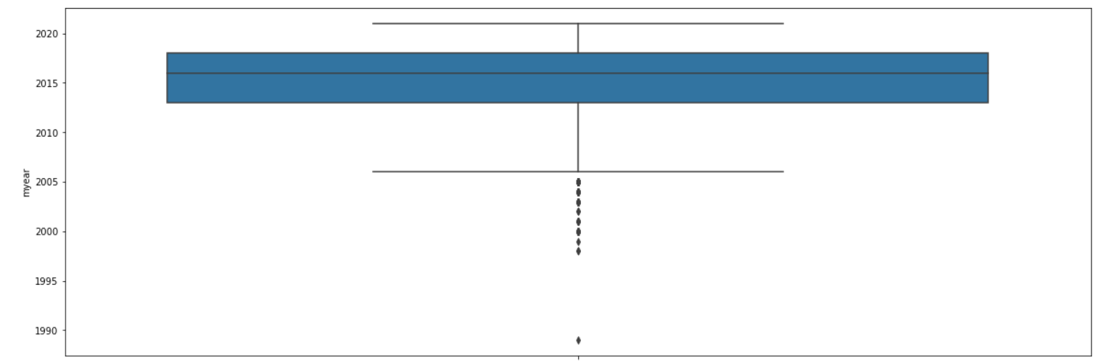
Exploratory Data Analysis performed on the dataset
Outliers Example from our dataset –

Slide 6
Exploratory Data Analysis performed on the dataset
6) Normal distribution of data:
myear-> not normally distributed
price-> Not normally distributed
km-> Not normally distributed
The data will be required to be normalized before building any model to increase the accuracy of the model
Normalization of the model is checked by plotting distance plot via libraries available in python

Slide 7
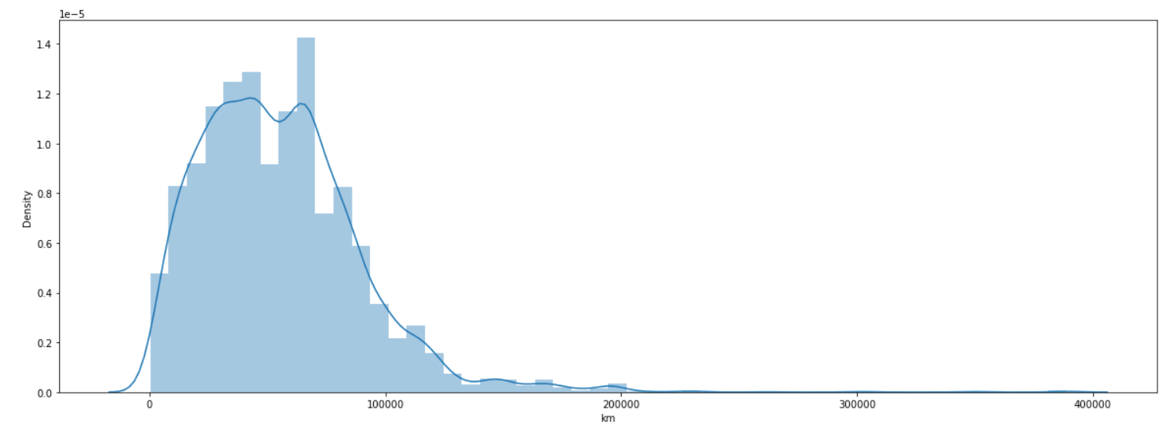
Exploratory Data Analysis performed on the dataset
Example of distplot from the dataset –

Slide 8
Exploratory Data Analysis performed on the dataset
7) Dataset was highly skewed, Before training the model skewness is required to be removed.
8) Removing Outliers: We replaced the outliers using IQR method. To increase the dataset quality. We confirmed the removal of outliers by plotting BoxPlot for the dataset
Code Logic Snippet:
IQR = df[col].quantile(0.75)-df[col].quantile(0.25)
Barmax = df[col].quantile(0.75) + 1.5*IQR
Barmin = df[col].quantile(0.25) - 1.5*IQR
df.loc[df[col]>Barmax,col] = Barmax
df.loc[df[col]<Barmin,col] = Barmin

Slide 9
Scaling the data
We Scaled the data using MinMaxScaler methodology
Code Logic Snippet
scaler = preprocessing.MinMaxScaler()
minmax_df = scaler.fit_transform(fin_df)
final_df = pd.DataFrame(minmax_df, columns = fin_df.columns)

Slide 10
Removing Skewness
We tried different methods to remove skewness -> Log method, Sqrt method, Power Method,
Power Method removed the skewness perfectly.
Code Snippet:
fin_df_new=power_transform(final_df)
fin_df_new = pd.DataFrame(fin_df_new,columns=final_df.columns)

Slide 11
Train Test Split
We split the data into training and testing categories with 7:3 ratio.
We used inbuilt function in the model_selection library of python
Code snippet:
x_train,x_test,y_train,y_test = train_test_split(x,y,test_size=.30,random_state=5)

Slide 12
Model training
We used different Models and compared the accuracy of the models:
Linear Regression
Decision Tree
Lasso
Ridge
Random Forest
ElasticNet

Slide 13
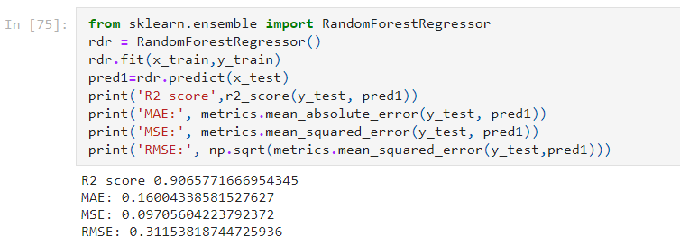
Model Training
After Cross Validation the best fit model is RandomForestClassifier Model with R2 score of 0.90

Slide 14
Thank you

